Slide 1

Exploratory Data Analysis
G2M insight for Cab Investment firm
Name : DR. Aftab Ara Location: Saudi Arabia Team: Data and Analytics Date: 15-March-2021

Slide 2

Agenda
Executive Summary
Problem Statement
Approach
EDA
EDA Summary
Recommendations

Slide 3
Executive Summary
XYZ is a private firm in US. Due to remarkable growth in the Cab Industry in last few years and multiple key players in the market, it is planning for an investment in Cab industry and as per their Go-to-Market(G2M) strategy they want to understand the market before taking final decision.
Objective : Provide actionable insights to help XYZ firm in identifying the right company for making investment.
Areas to investigate:
Investigate and understand each data set.
Which company has maximum cab users at a particular time period?
Does margin proportionally increase with increase in number of customers?
What are the attributes of these customer segments?

Slide 4
Problem Statement
XYZ is a private firm in US. Due to remarkable growth in the Cab Industry in last few years and multiple key players in the market, it is planning for an investment in Cab industry and as per their Go-to-Market(G2M) strategy they want to understand the market before taking final decision.
Their problem is their inability to identify the right company for making investment.

Slide 5
Approaches taken
Data was taken from github
Data was cleaned and data types checked.
Table relationship was found and each table was linked to the table with primary and secondary key
Tables were modelled according to their relationship
Profit of rides are calculated keeping other factors constant and only
Price_Charged and Cost_of_Trip features used to calculate profit.
Users feature of city dataset is treated as number of cab users in the city including yellow and pink cab users

Slide 6
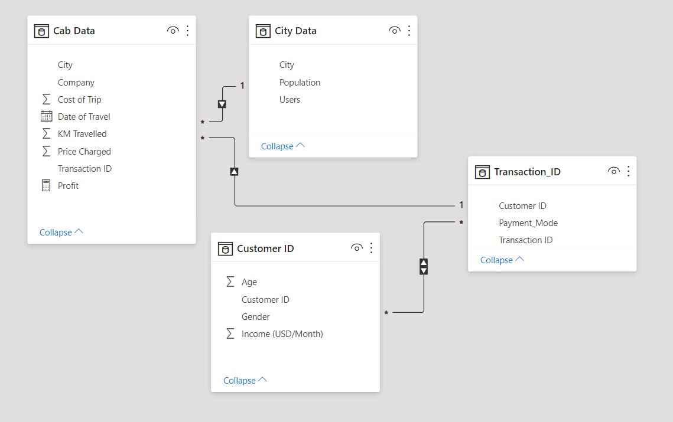
Table Relationship
Cab data and City Data tables are linked by similar fields city with one to many.
Similarly Cab Data and Transaction ID are linked by Transaction ID with one to many relationship
Table Transaction ID is linked to Customer ID with many to many relationship

Slide 7
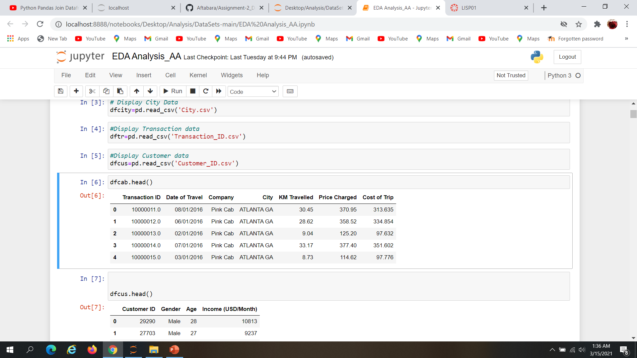
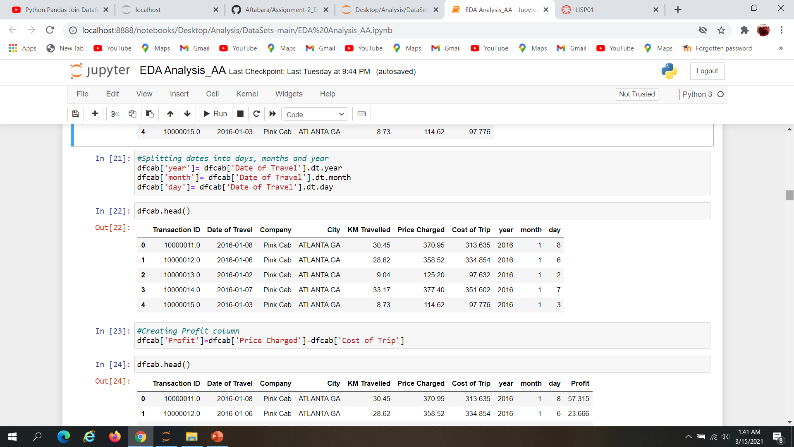
Cab Data
Before
After transforming it by year ,month and day

Slide 8
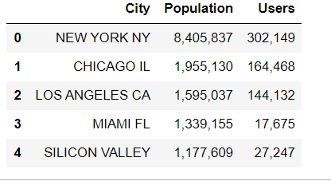
City Data

Slide 9
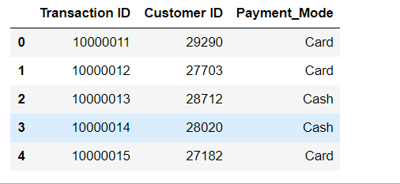
Transaction Data

Slide 10
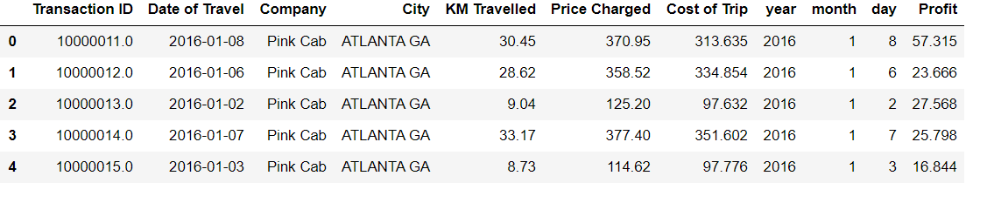
Cab data with profit column

Slide 11
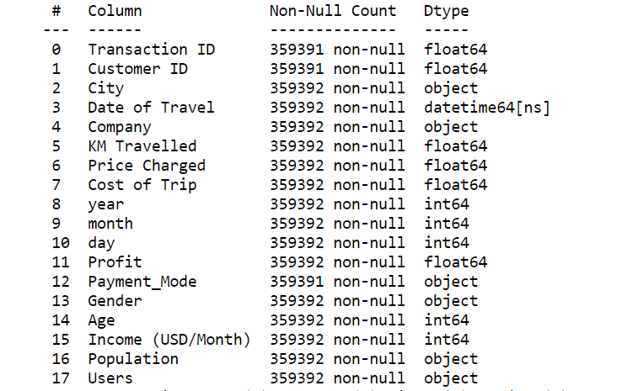
Column Information after joining Cab Data, Transaction ID, Customer ID & City Tables

Slide 12
Assumptions taken
We are analyzing the data based on the assumption that the Yellow cab is better than Pink Cab

Slide 13
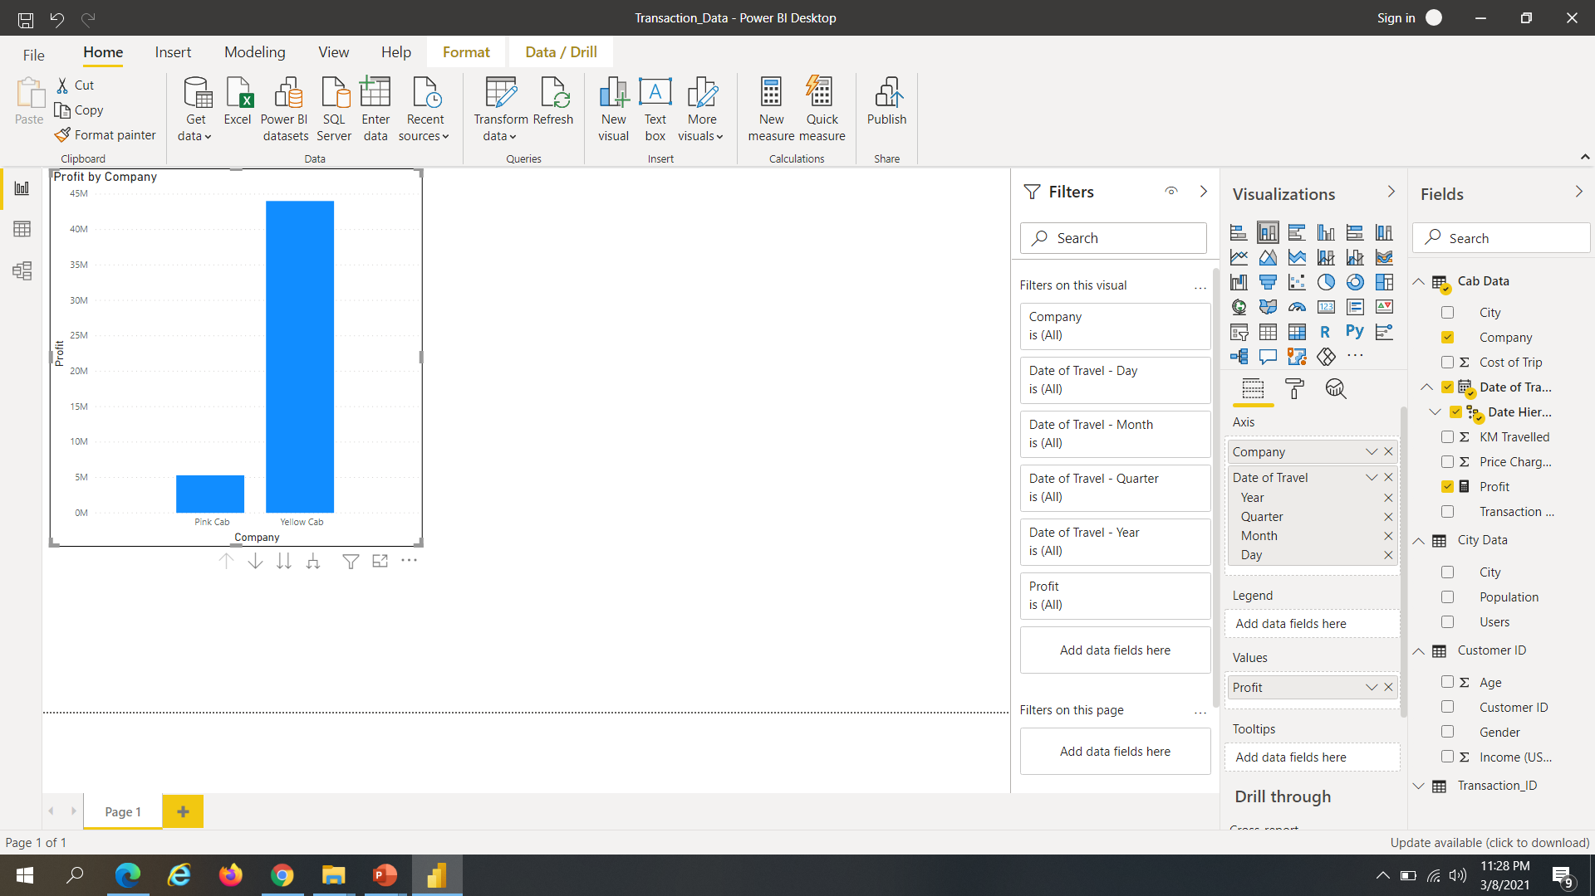
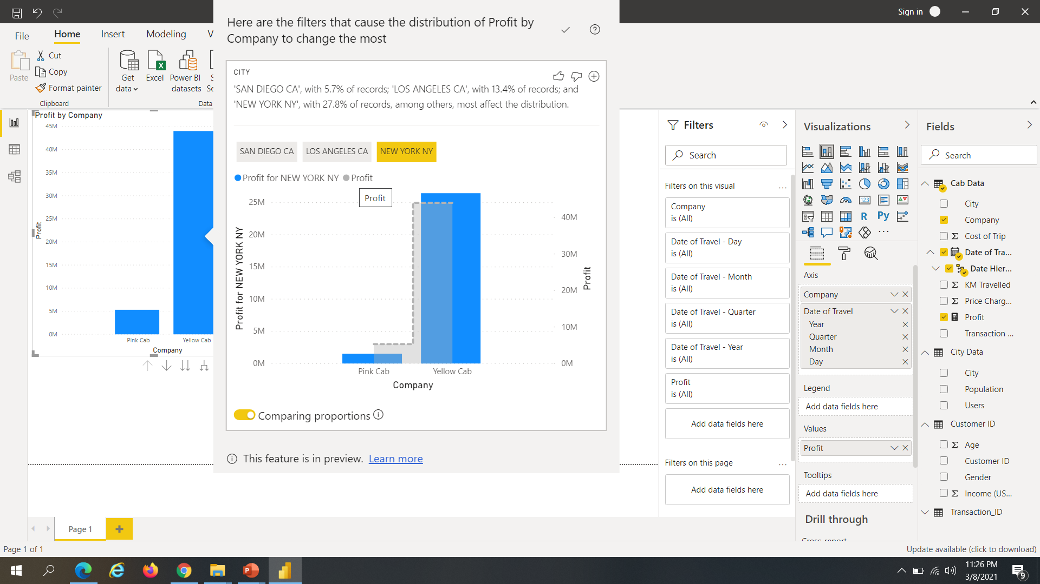
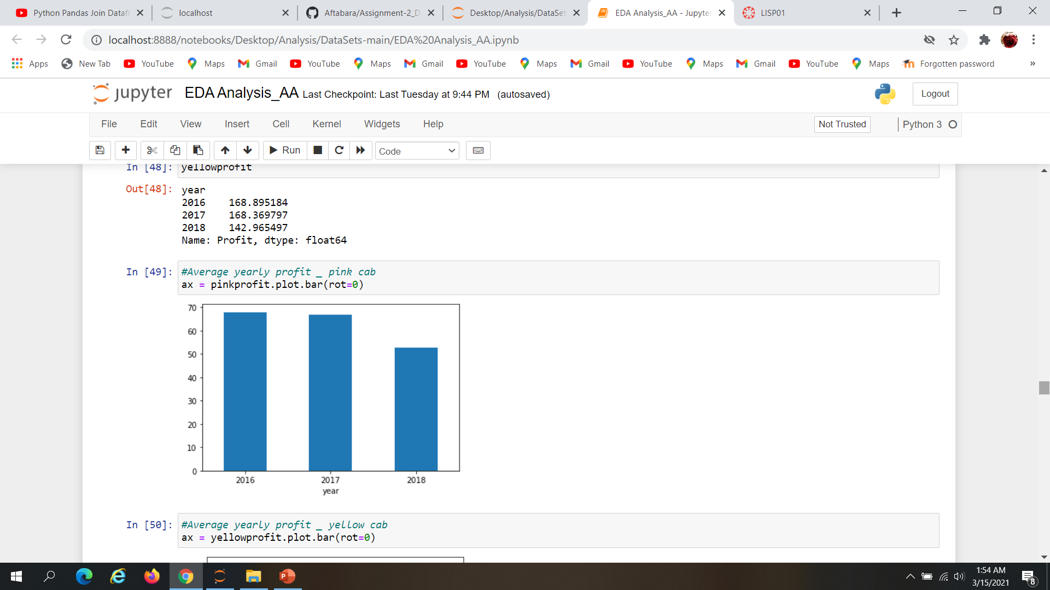
Analysis-Profit earned being dependent on Company
The conclusion which can be drawn from the graph that the Yellow Cab can be seen having more profit with New York with 27%

Slide 14
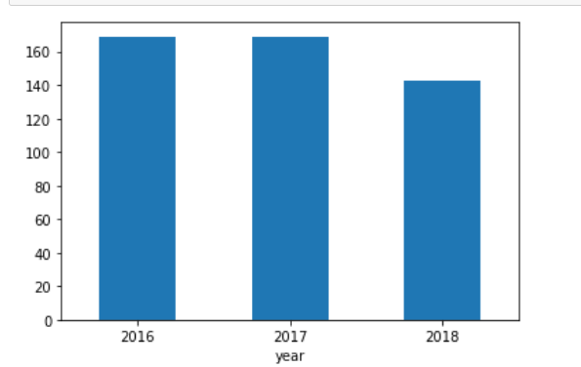
Yearly Analysis of company
Analysis of the two bar chart summarizes that the Yellow Cab has more yearly profit than the pink Cab
Average yearly profit of the pink cab
Average Yearly profit of Yellow Cab

Slide 15
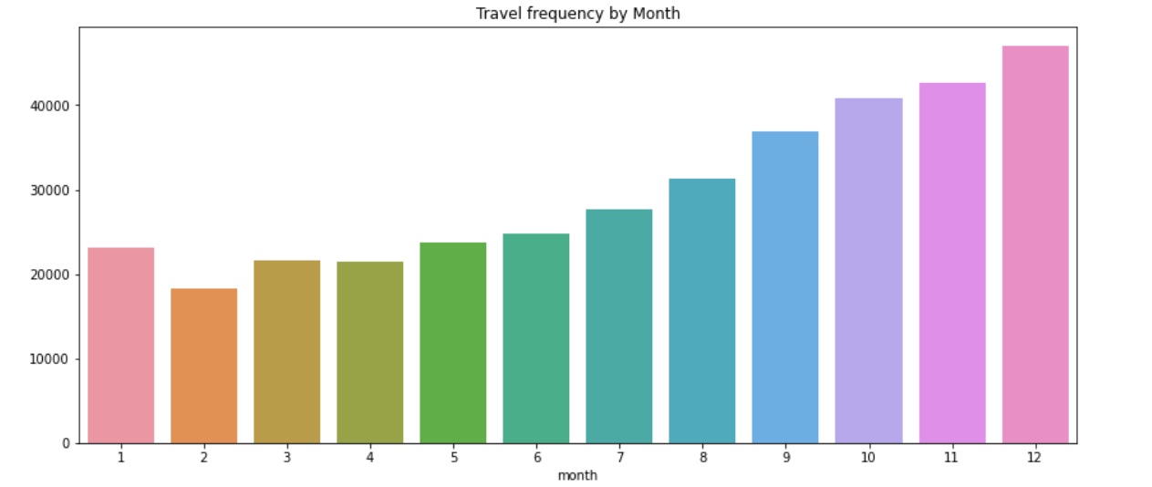
Analysis- Travel frequency/Month
Travel frequency per month shows more travel during the end of the year

Slide 16
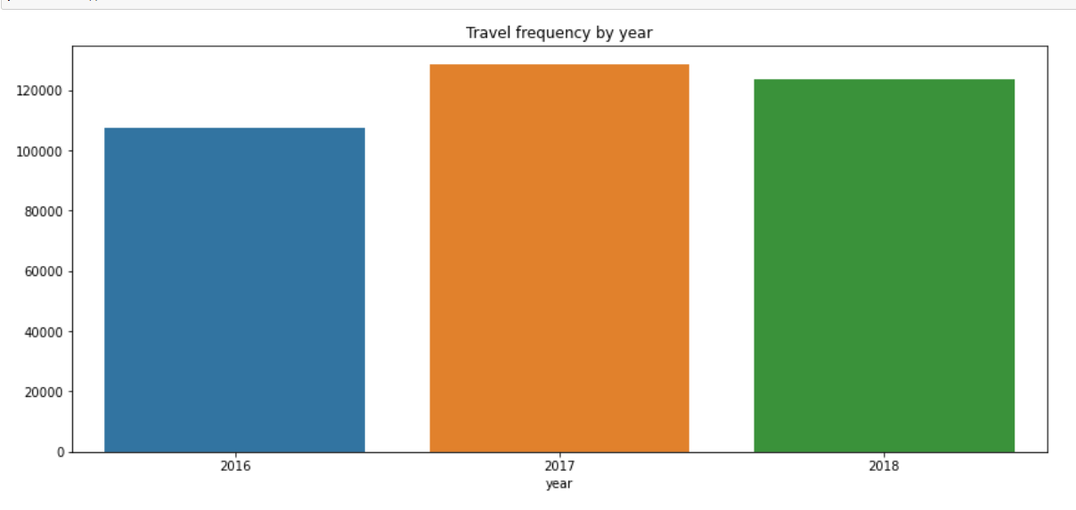
Analysis-Travel Frequency/Year
The chart helps us to confirm that in 2017 there was maximum trips in comparison to Year 2016 and 2018.

Slide 17
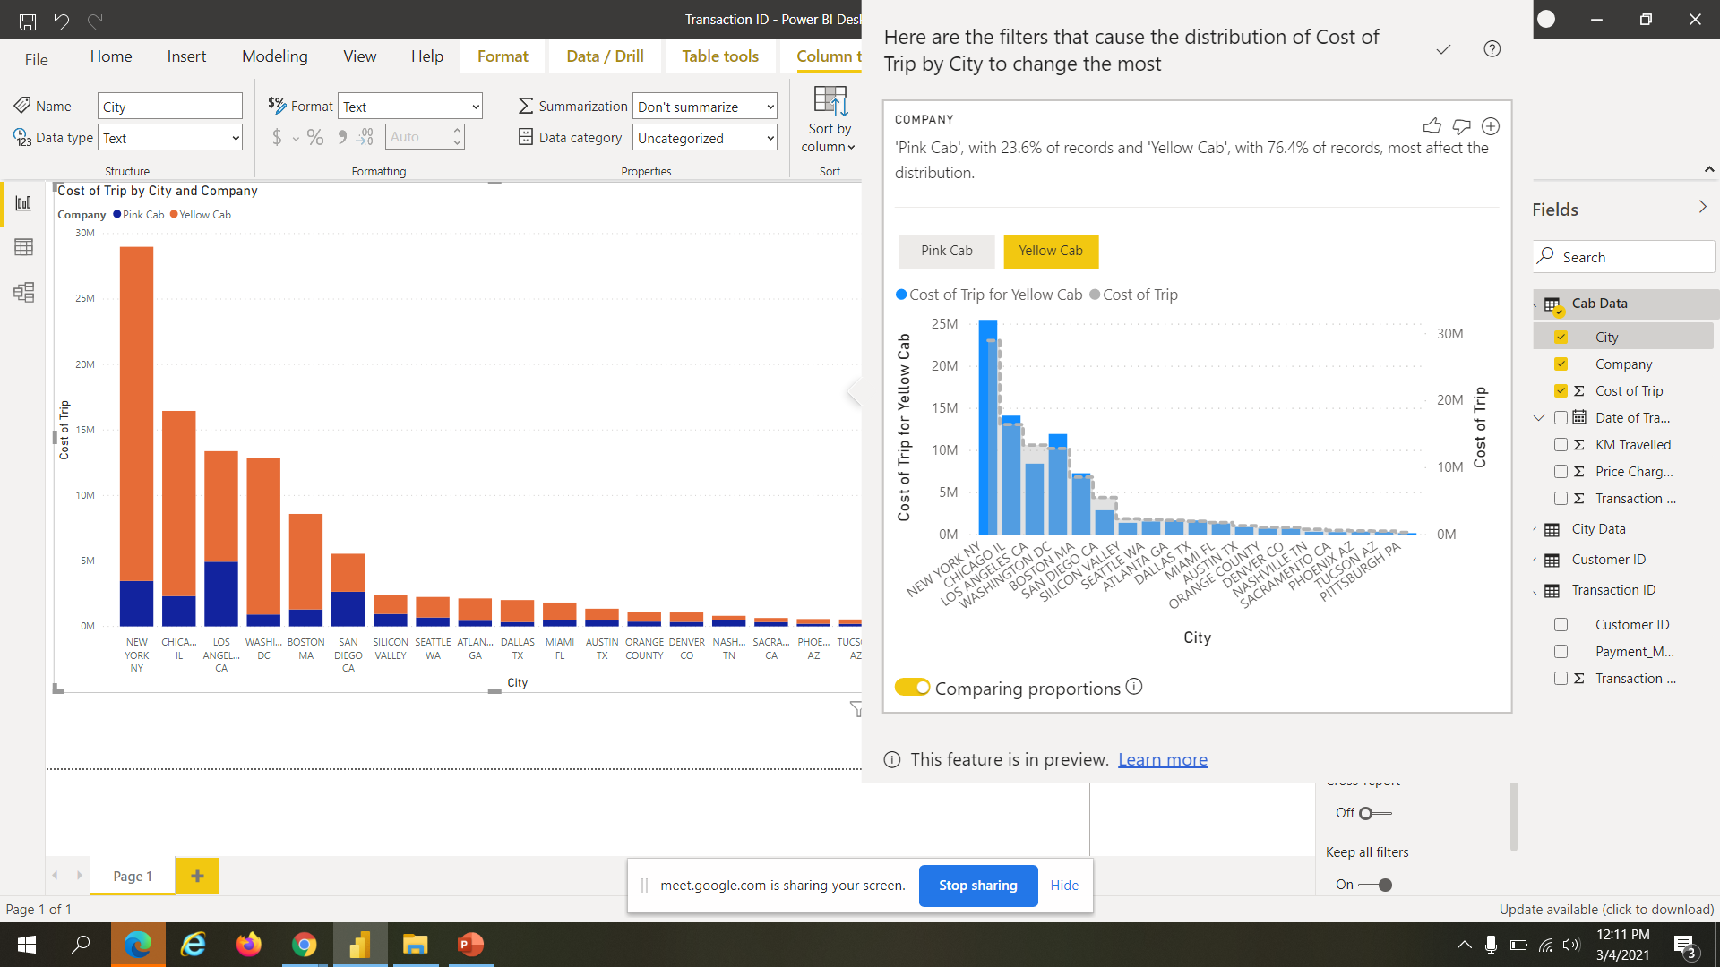
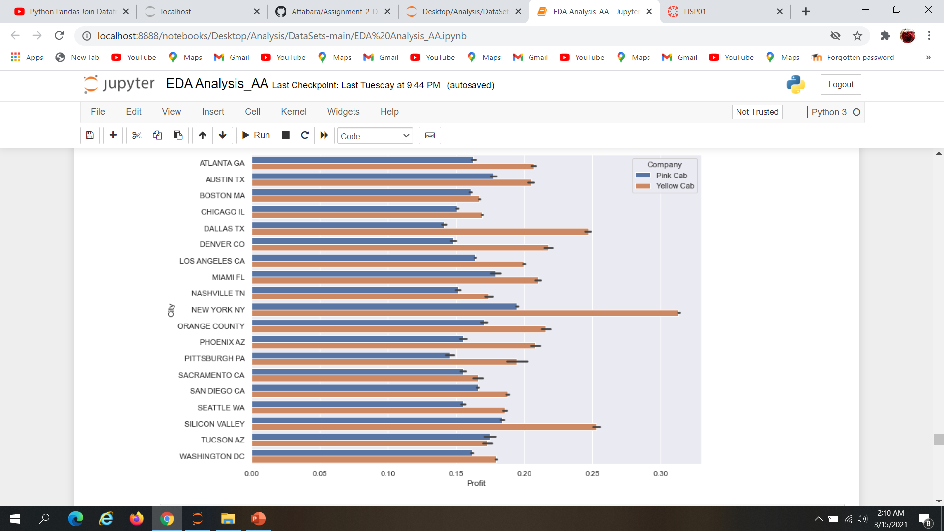
Analysis -Cost of Trip by City and Company
While comparing City visit in relation to company record shows pink Cab with 23.6% of records and Yellow Car with 76.4% .

Slide 18
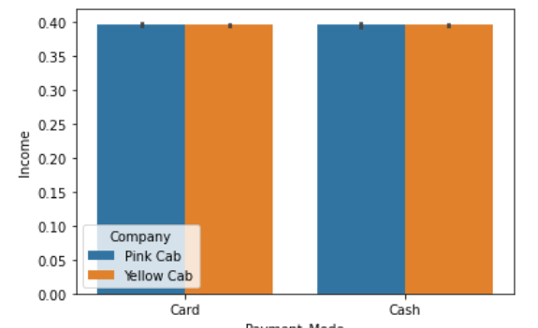
Analysis-Payment Mode
The payment mode analysis by both the Yellow and Pink Cab’s are equally distributed for cash and Card

Slide 19
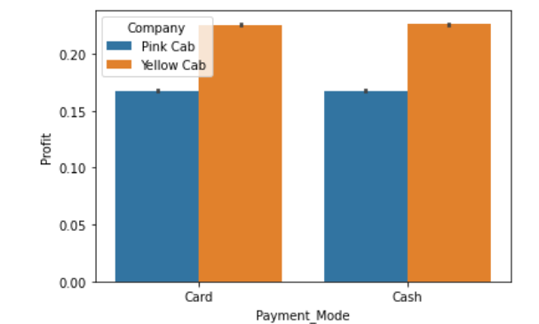
Analysis-Payment mode and Profit
The analysis of Payment mode and profit for both the companies are equal

Slide 20
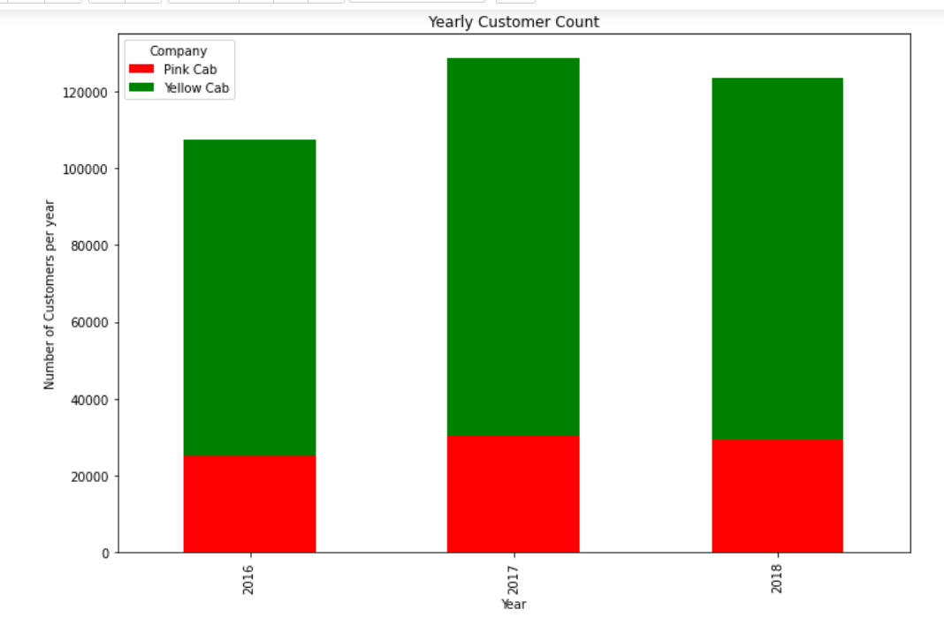
Analysis -Yearly customer Count
The conclusion can be drawn from the yearly customer count which shows the yellow cab leading in the number of customers .Further Year wise the yellow cab has the maximum number of customers in 2018

Slide 21
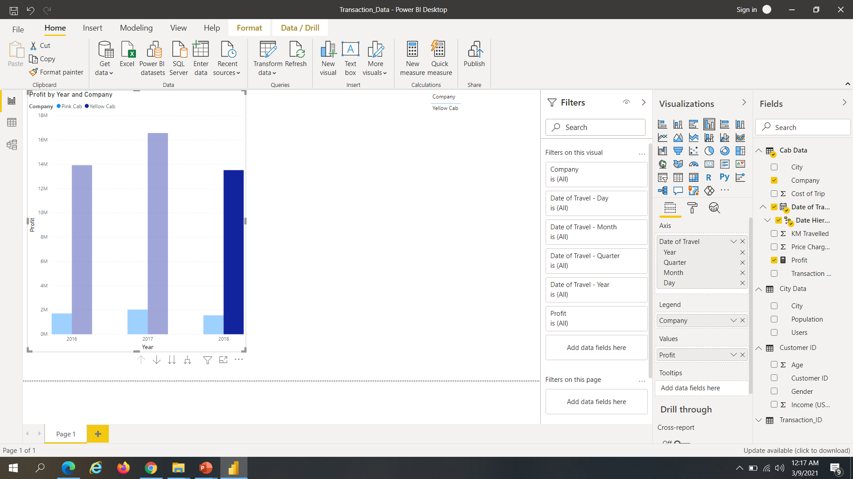
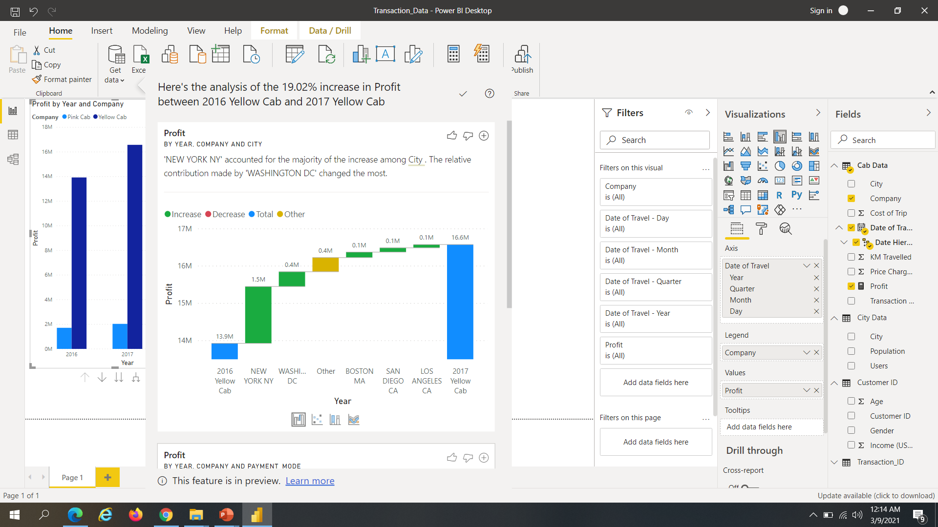
Analysis- Profit by Year, Company & City
Analysis of 19.02% increase in profit between 2016 Yellow Cab and 2017 Yellow Cab

Slide 22
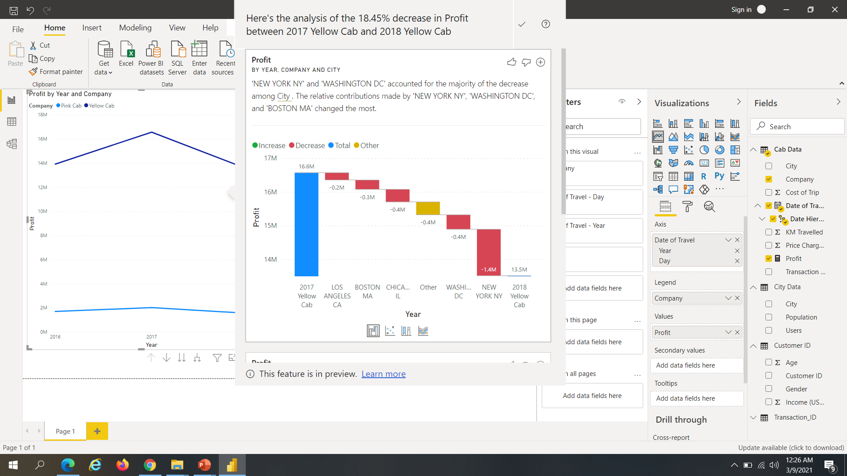
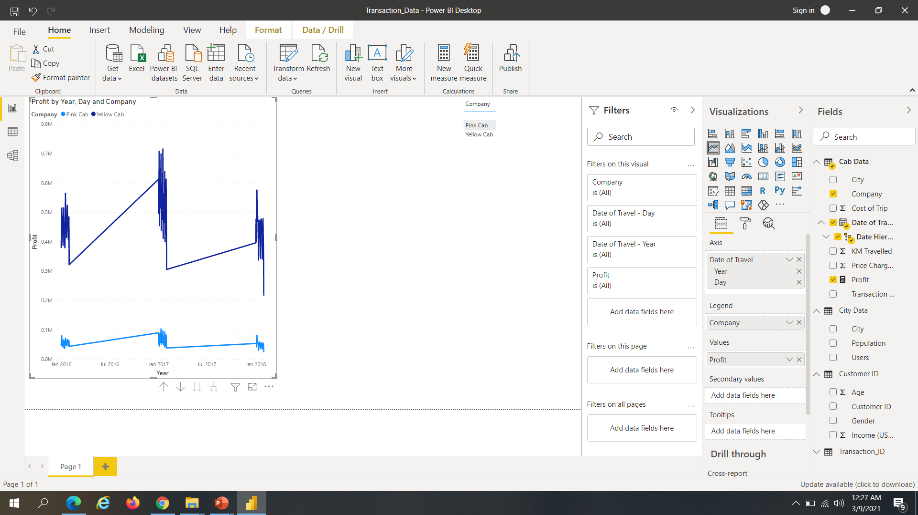
Analysis-Decrease in Profit by year, day and Company
In Conclusion from the plot we can analyze 18.45% decrease in profit between the 2017 Yellow Cab and 2018 Yellow Cab thus concluding that yellow Cab had maximum profit in 2017

Slide 23
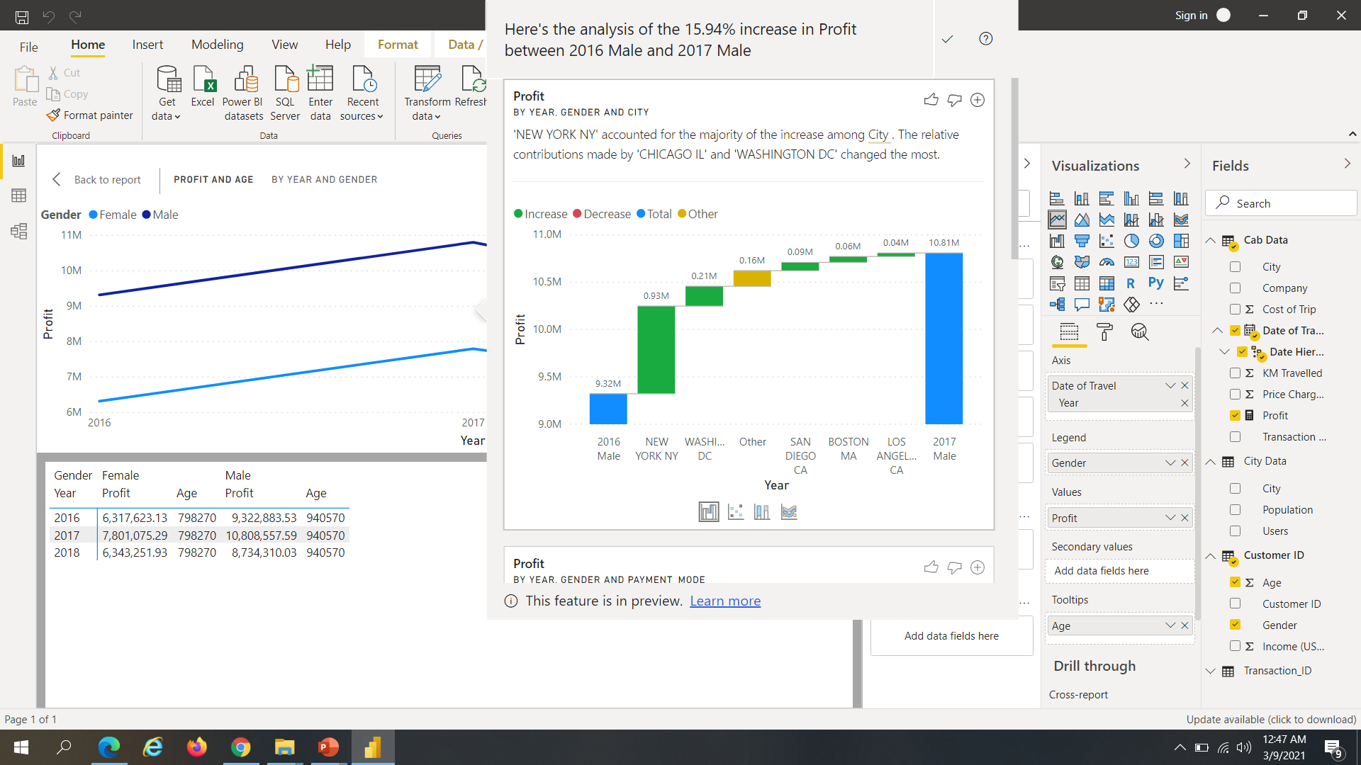
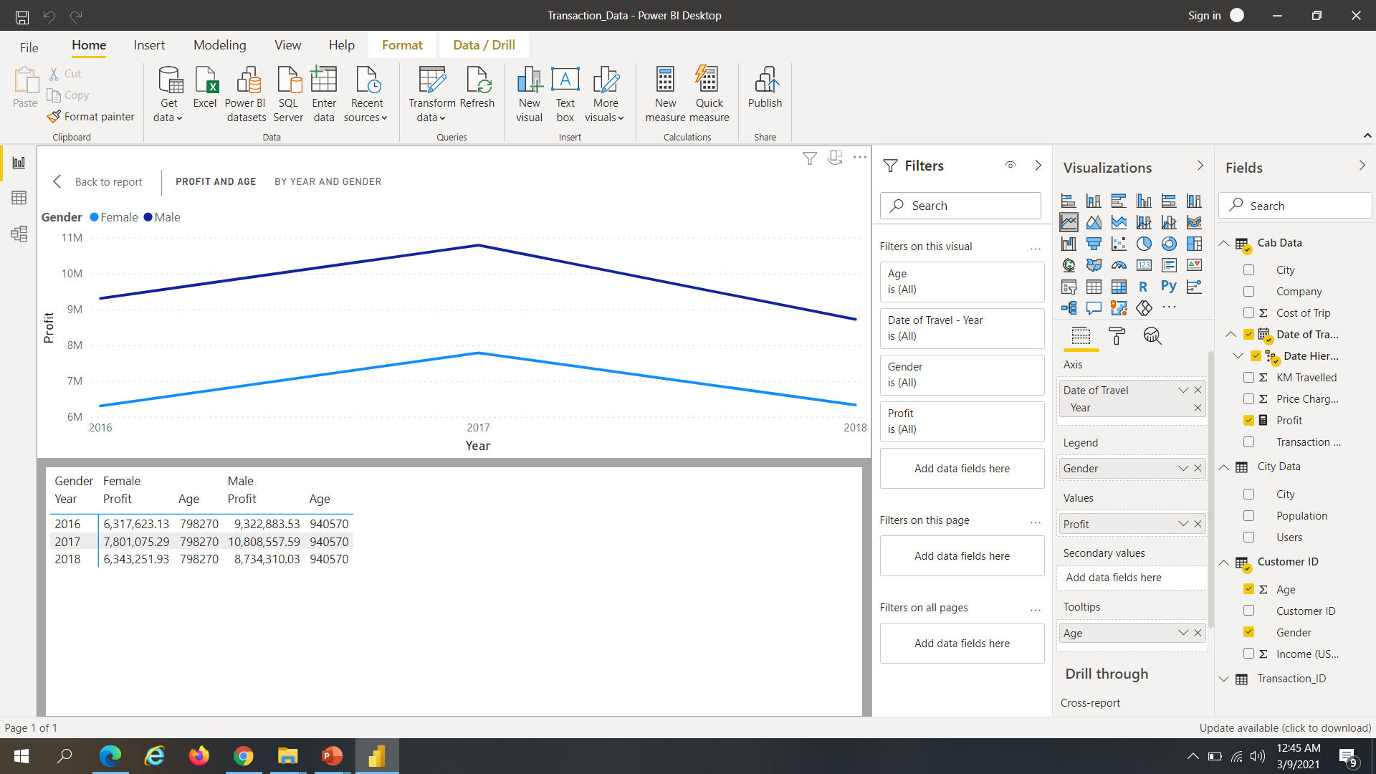
Analysis-Profit by Customer base ( Age )
We can conclude from the given analysis that the males contributed by having 15.94% more profit from 2016 to 2017

Slide 24
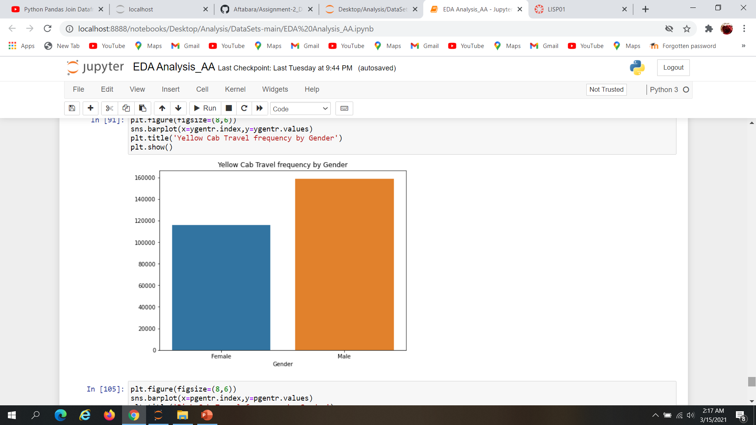
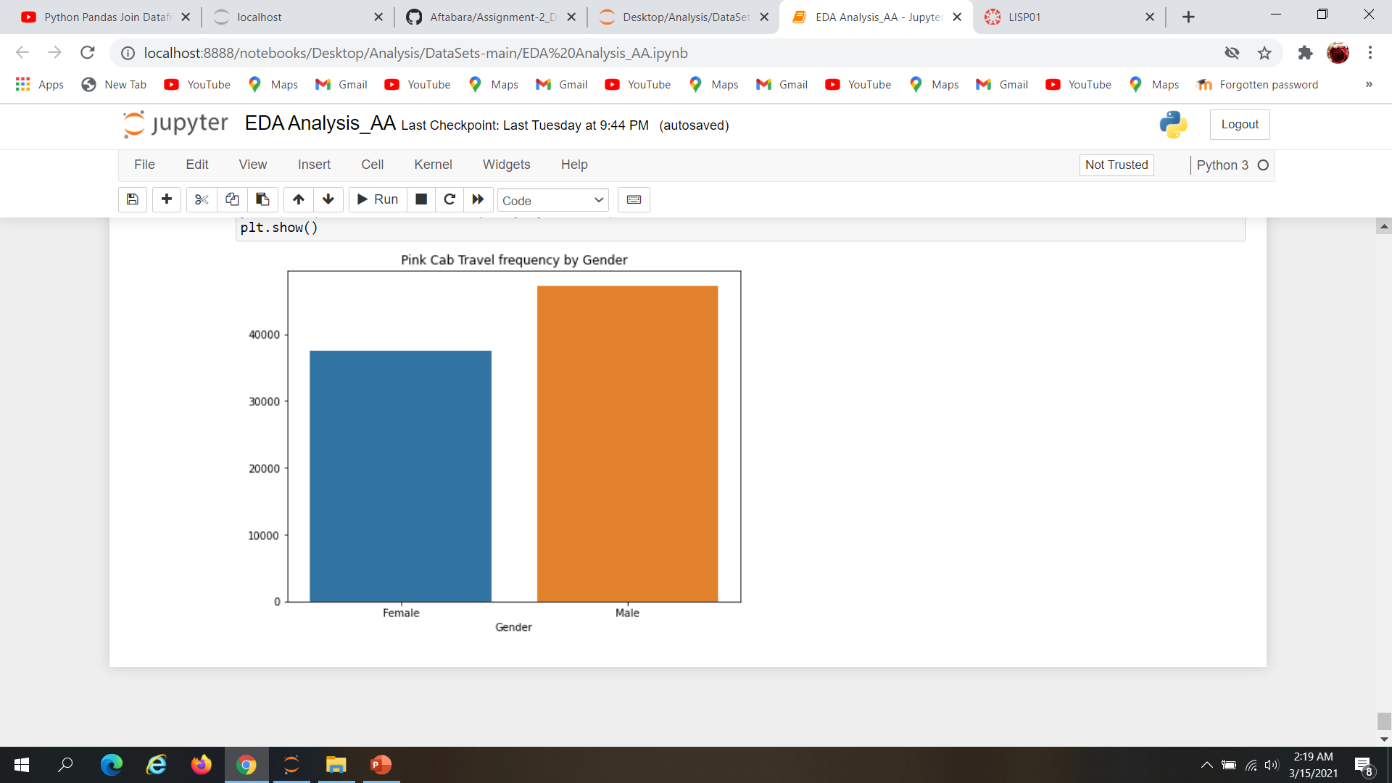
Analysis-Travel Frequency by gender
The Bar plot analysis confirms that travel frequency for males is for both the yellow Cab and Pink cab

Slide 25
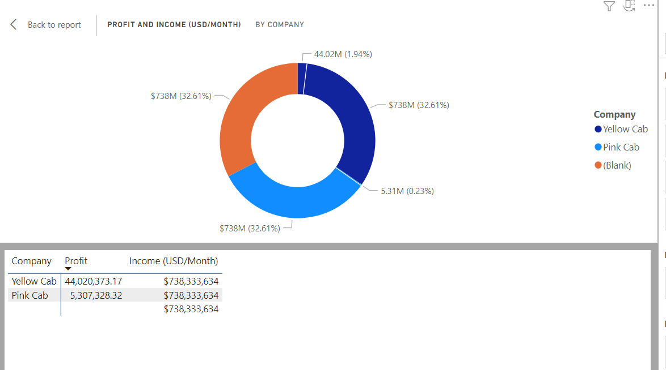
Analysis- Profit and Income according to Company
The donut chart shows that the Yellow cab has more profit than the Pink cab

Slide 26
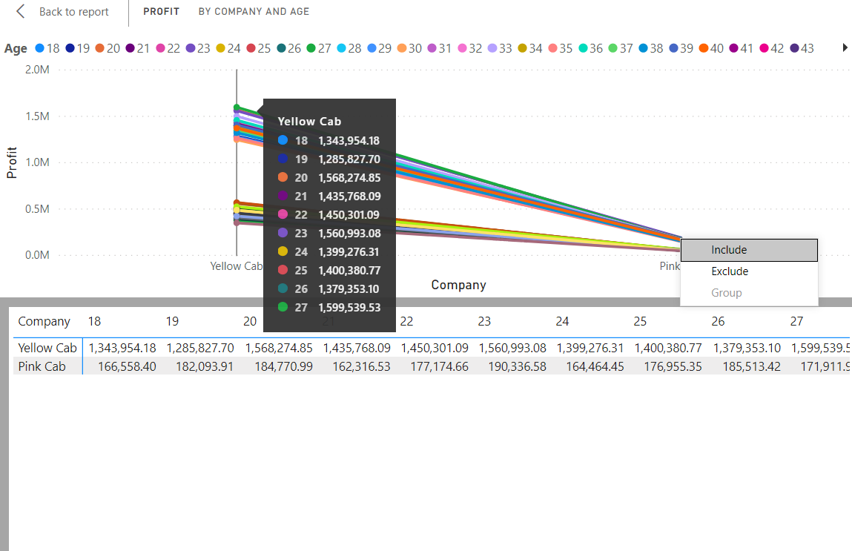
Analysis-Customer Segmentation
The following analysis confirms that the customer segmentation was basically of 27 year old’s who made the maximum usage of yellow Cab

Slide 27
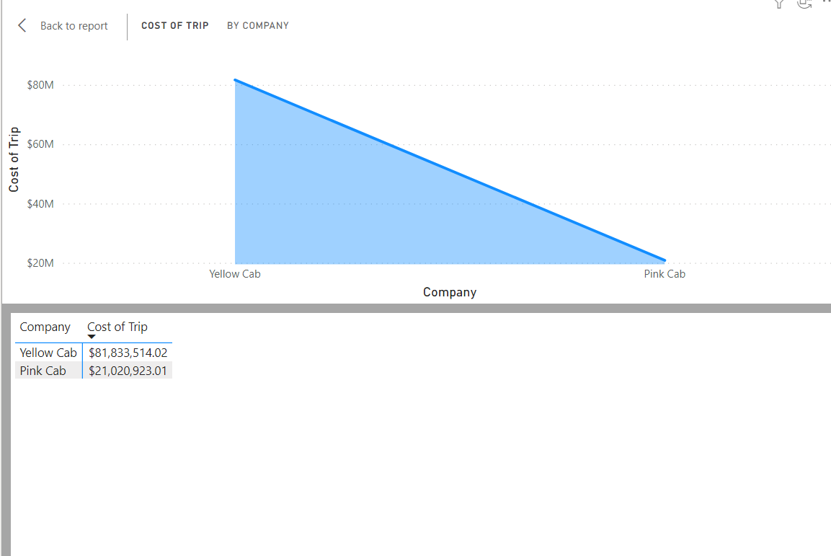
Analysis-Market Demand of company
The analysis shows clearly that though the yellow cab had higher cost of trip ,still it was preferred by most of the users

Slide 28
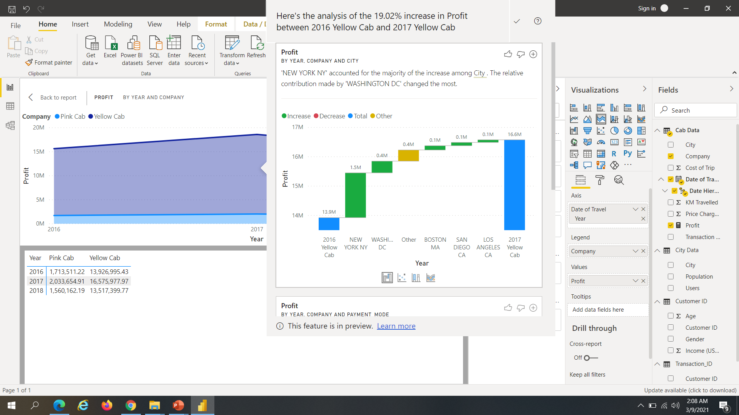
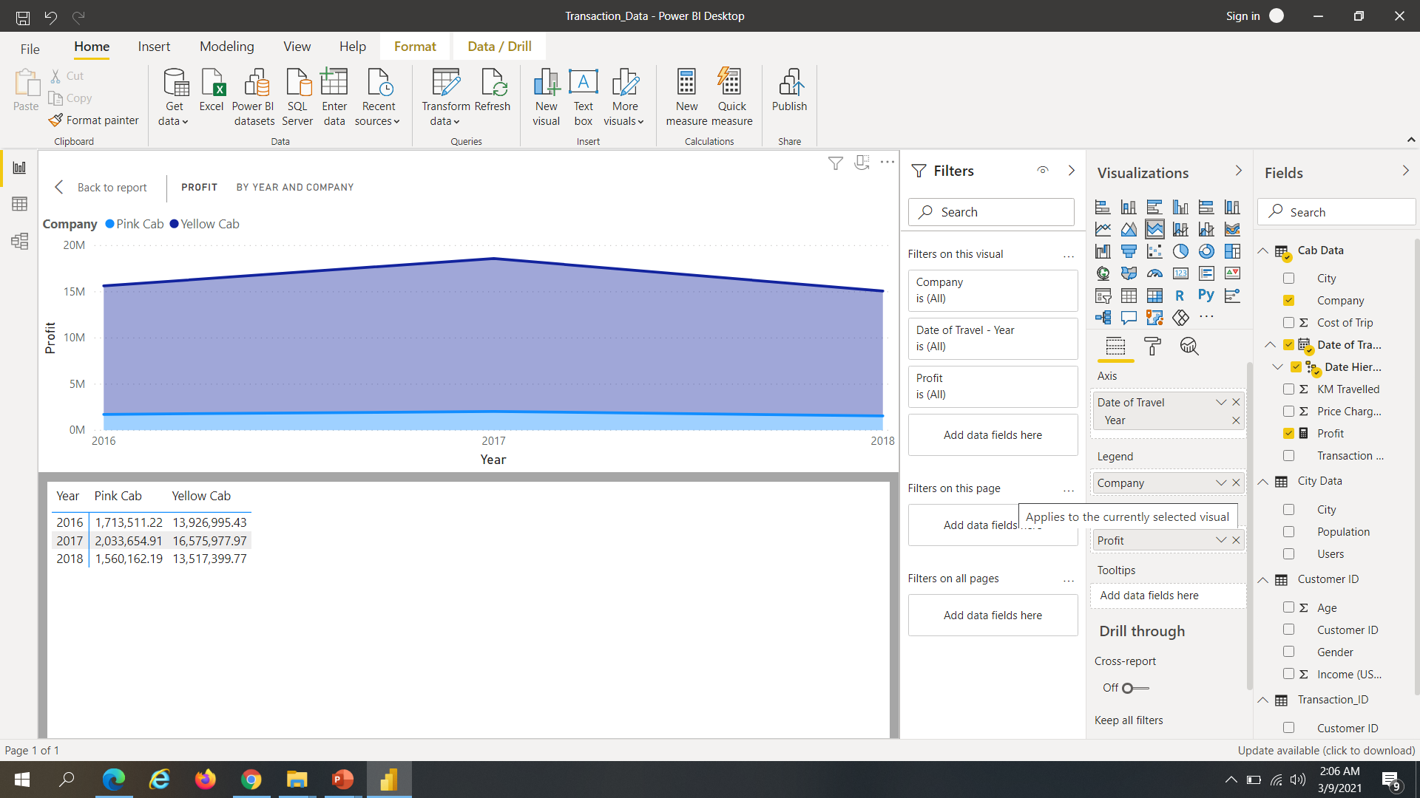
Analysis-Profit distribution by year and Company

Slide 29
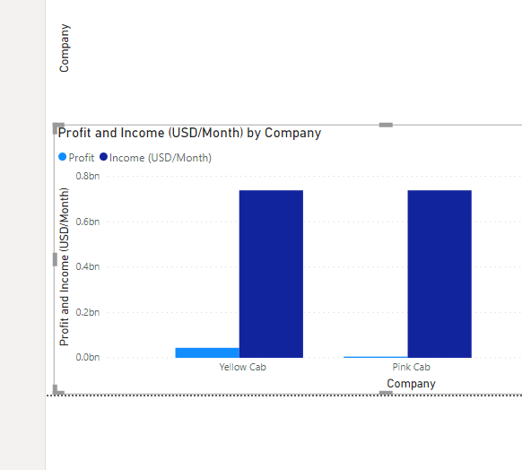
Analysis-Profit and Income by Company
The Yellow Cab Company had more profit than the Pink Cab

Slide 30
Recommendation for using the Yellow Cab
We have gauged both the cab companies on following points and found Yellow cab better than Pink cab:
City Travelled: Record shows pink Cab with 23.6% of records and Yellow Car with 76.4% thus Yellow cab precedes the pink Cab
Customer Reach : Yellow cab leading in the number of customers reach .Further Year wise the yellow cab has the maximum number of customers in 2018
Yearly Profit Analysis :Analysis of 19.02% increase in profit between 2016 Yellow Cab and 2017 Yellow Cab thus here too Yellow cab shows more profit from the pink cab. Moreover the Yellow Cab has more yearly profit than the pink Cab
Gender wise Reach : Males contributed by having 15.94% more profit from 2016 to 2017 from females and they have more frequency of travel in both Yellow and Pink cabs.
Age Distribution: Age segmentation was basically of 27 year old’s who made the maximum usage of yellow Cab
Market Demand: Though the yellow cab had higher cost of trip ,still it was preferred by most of the users showing its high demand in the market
Income wise Reach :Both the cabs are very popular in high and medium income class (yet the Yellow cab is having higher profit
Yearly Trips : Analysis shows that more trips occur by the end of the month with maximum trips taken in the year 2016.
Yellow cab is better than the Pink Cab for investment due to above recommendations.

Slide 31
Thank You

